Slide 1
Pestis: A rat-based strategy game
Team Pickled Rat
Ani Boja, Murray Groves, Harvey Caldeira, Chongsheng Wang, Shayaan Ahmed, Vinh Bui

Slide 2
Premise
You control a rat horde that wants to take over earth!
Compete with other rat hordes in this exciting multiplayer real-time strategy game. Breed and evolve your horde, capture strongholds, defend yourself from humans, and defeat the other rats who dare stand in your way.
Notes:
~ 30 seconds

Slide 3
Flagship tech
Simulation of complex evolutionary dynamics
Modifying agent behaviour based on their genetics
Available mutations depend on all previous ones
How do different mutations interact?
Simulation of the movement of 1000s of rats
Movement of colony as a whole
But also, individual rats within that
How do individual rats avoid obstacles without repeating calculations between rats?
Notes:
~ 30 seconds

Slide 4
Look & Feel
Isometric pixel game.
4X multiplayer real-time strategy.
Tone is unserious, matched by the vivid caricature-ish visual style.
Combat should feel familiar to those who've played real-time strategy games like Mount & Blade or Warhammer.
Exploration can be compared to other games that use a Fog of War.
Evolution system should feel like a more sophisticated version of Plague Inc mechanics.
Notes:
~ 1 minute

Slide 5
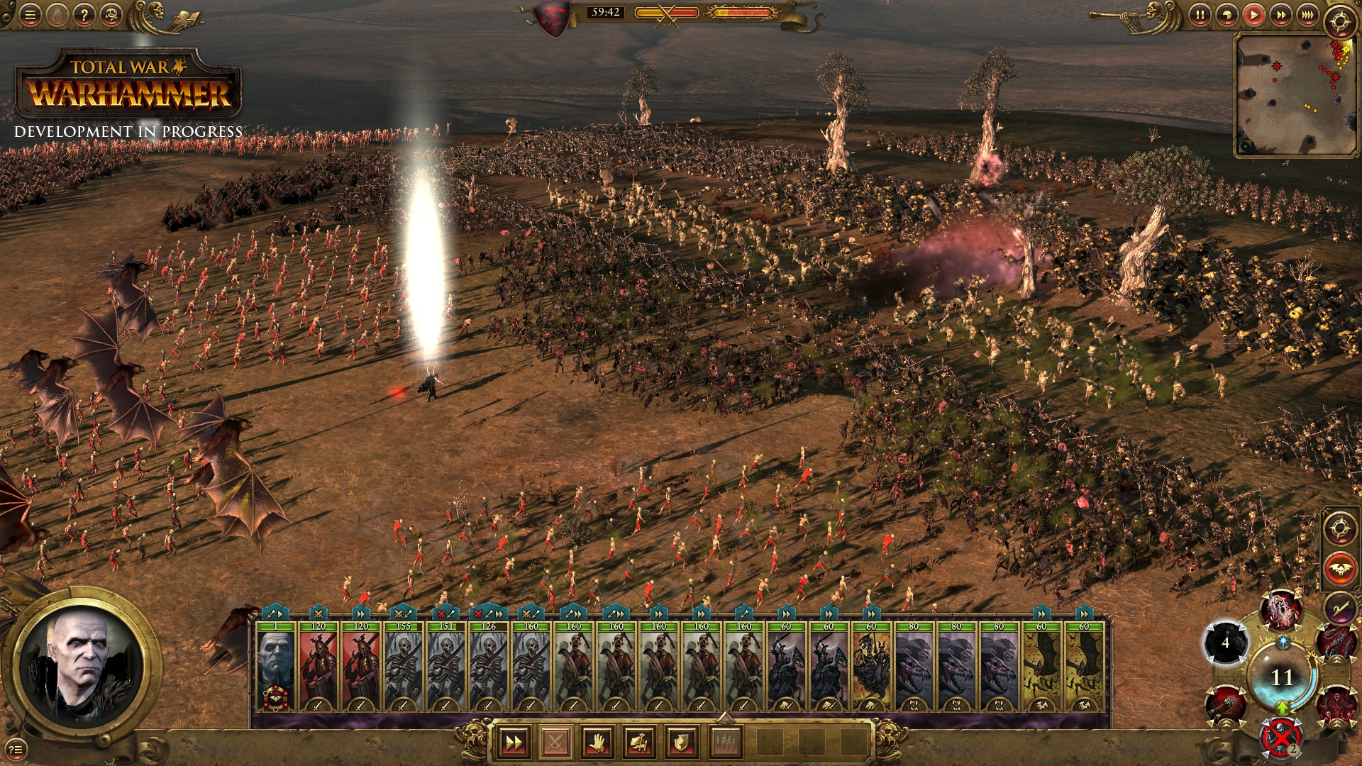
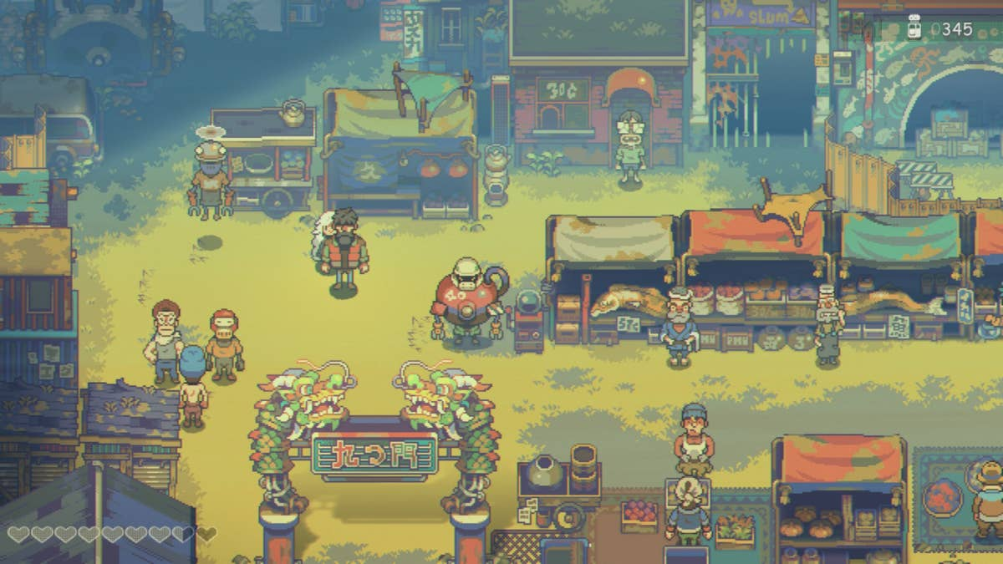
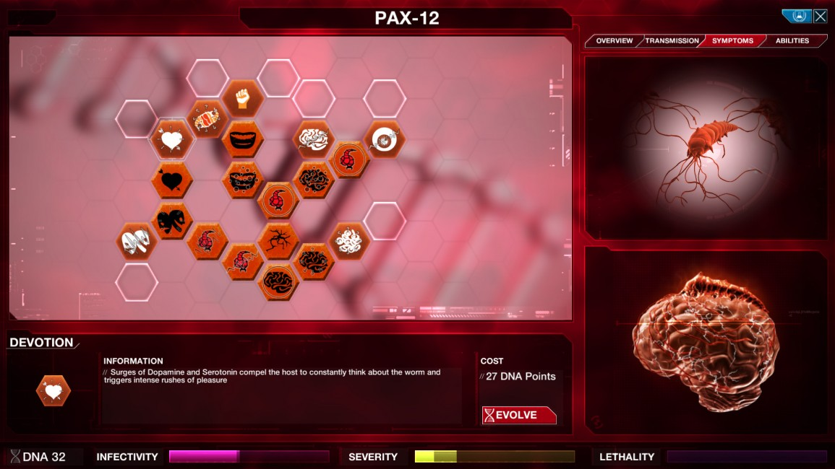
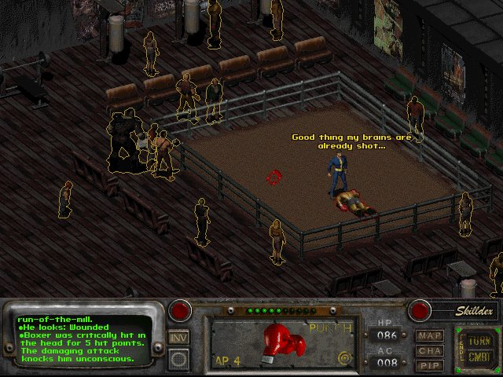
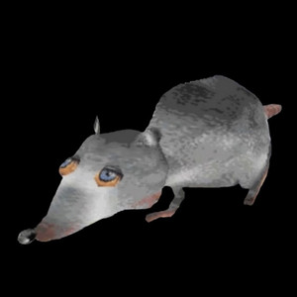
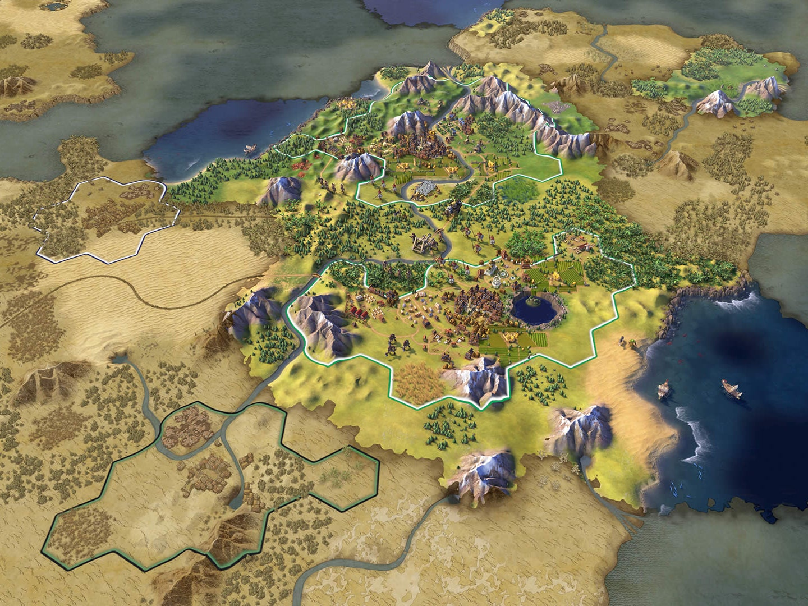

Slide 6
Goals & Gameplay loop
Your ultimate goal is to be the most populous rat horde.
Short-term – accumulate resources and engage in combat
Long-term – Carefully drive your rats to an evolutionary goal that will let them thrive
Send hordes to capture points of interest and explore.
Sabotage and interfere with human activity.
Prepare for attacks from human, pest control raids, and other rats.
Plunder resources from rats and humans.
Evolve your rats.
Expand!
Notes:
~ 1.5 minute

Slide 7
Gameplay Mechanics
Complex evolutionary tree, chance to develop either a negative or positive mutation.
Intermingle with new rat citizens to develop genetic diversity.
Cheese is your primary resource, facilitates evolution and combat.
Capture important locations like a dairy (cheese farms), rat forts, exterminator camps, and human settlements.
Variety of terrain like deserts, snow, radioactive zones etc. which affect what mutations you may develop.
Combat involves designing an attack strategy and providing live commands to your rat army.
Notes:
~ 1.5 minutes

Slide 8
That's all

